Slide 1
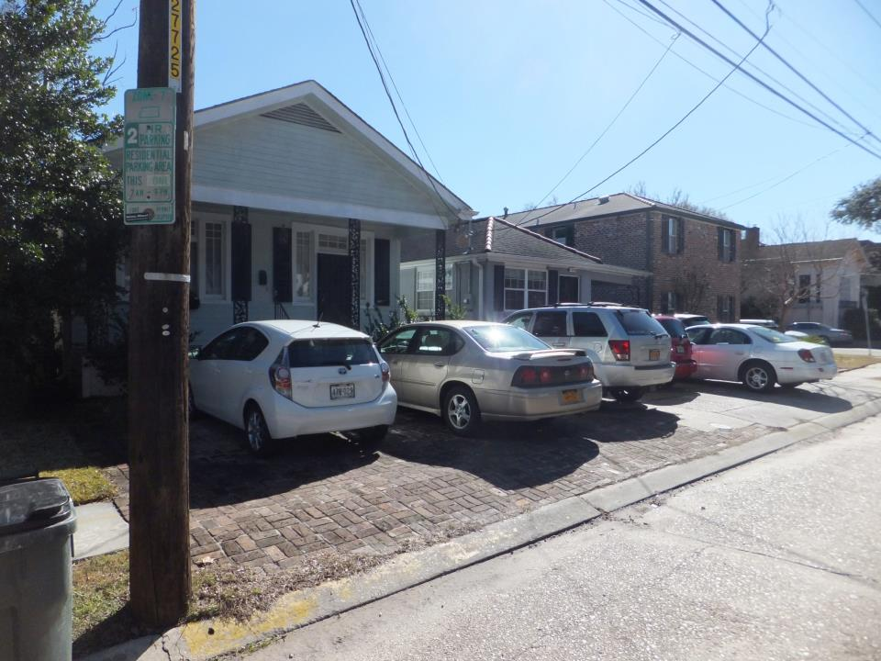
Yard Paving in new Orleans
What’s the Big Deal???

Slide 2
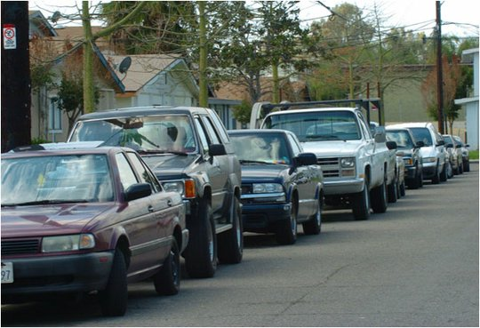
WHY PAVE??
Parking – Tulane, NYC, DC
Yard Maintenance

Slide 3
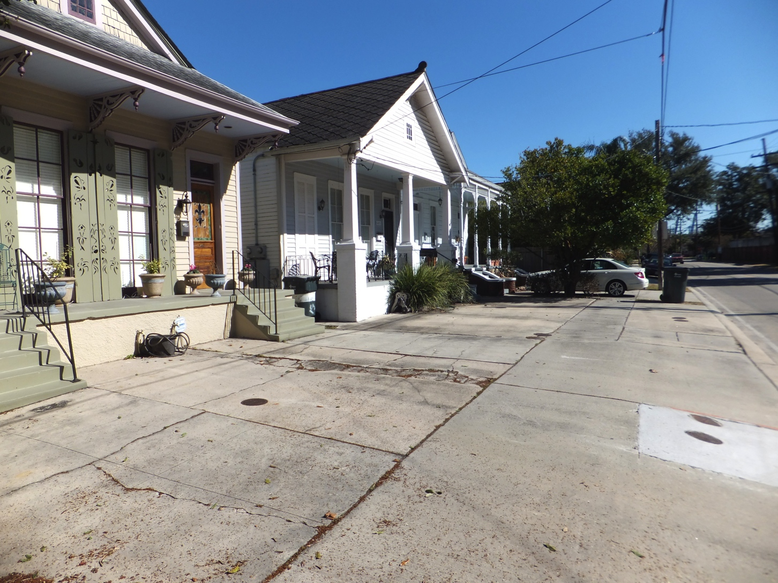
AESTHETICS
Ugly- loss of green space, concrete jungle
Property Values- London, domino effect

Slide 4
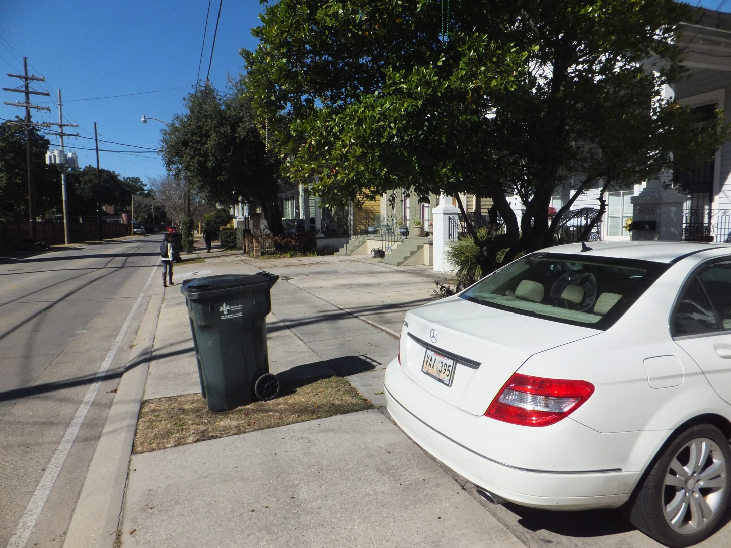
Quality of life/public safety
Pave over right of way – eliminating sidewalk
Eliminates a spot that was formerly street parking

Slide 5

Stormwater
Management
Runoff not allowed into soil
- street flooding
- increased pressure on storm sewer system - pumping
- pollutants in waterways
- subsidence

Slide 6
Enforcement
CZO - The pavement of a required front yard shall be limited to forty (40) percent of the required front yard area.
No permit is required to pave front yard space
Enforcement is after the fact, complaint driven
Usually long process of hearings and appeals (adjudication, BZA, etc.)

Slide 7
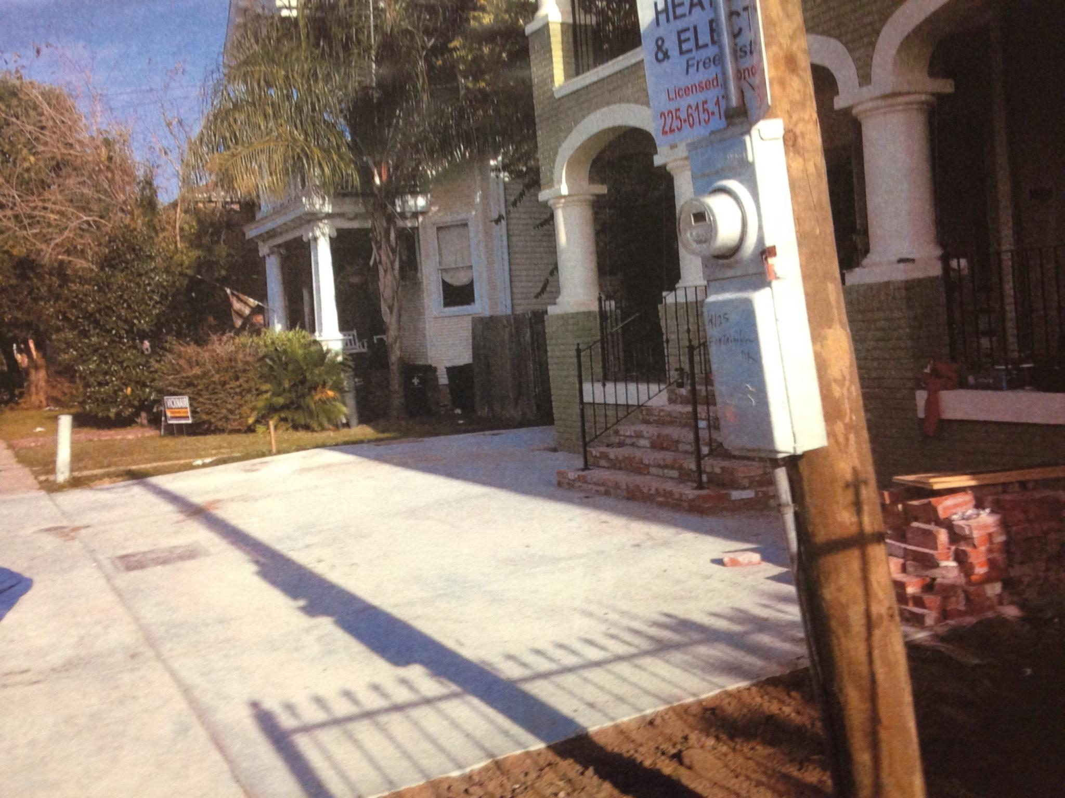
Before

Slide 8
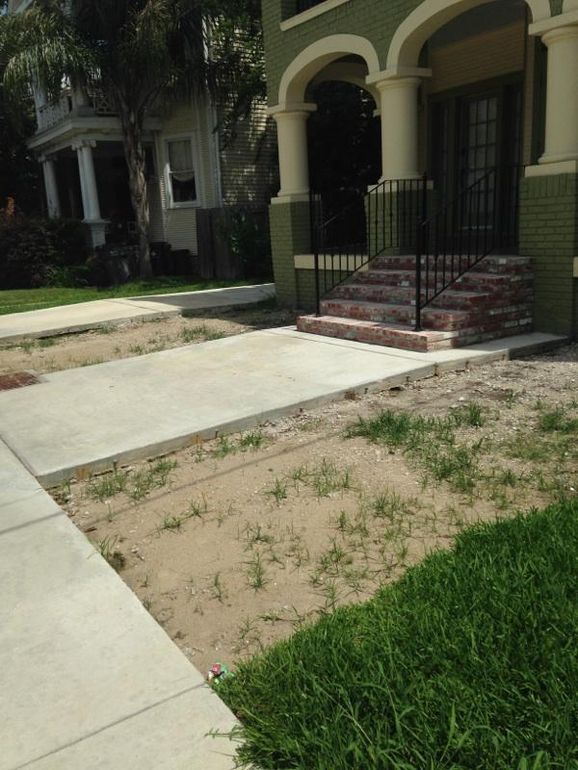
Compliance!!

Slide 9
Front Yard Initiative (FYI)
Goal: to provide New Orleans residents an opportunity to remove unwanted paving from their neighborhoods.
FYI will assist in removal of front yard impermeable surfacing in favor of a yard planted with green, native plants with an emphasis on utilizing stormwater best management practices (BMPs) and Complete Streets methodology.

Slide 10
How it works
Fees range from $200-$300 depending on # of applicants per block and size of yard
Participants must attend several planning and educational sessions
Program provides concrete removal, native plants, landscaping/green infrastructure expertise, and installation

Slide 11
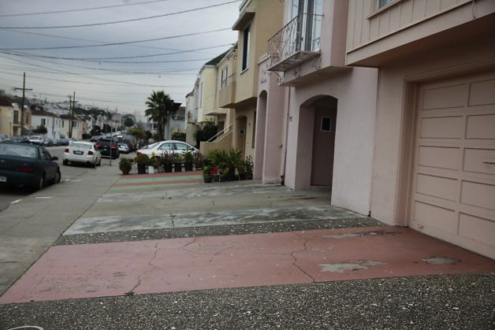
Before

Slide 12
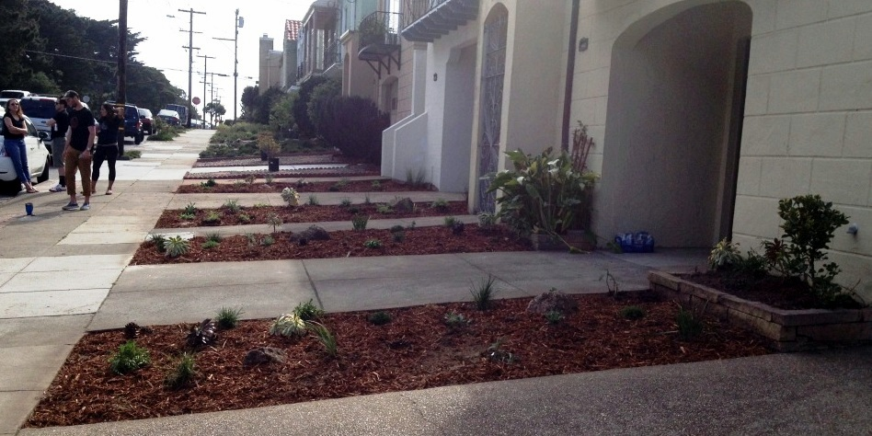
AFTER!!

Slide 13
Urban Conservancy
Urbanconservancy.org
dana@urbanconservancy.org
travis@urbanconservancy.org
Or give us your email and we’ll reach out to you

